Slide 1

TRiCAM QRI Project
Understanding the Behavior of Oil Wells through Deep Learning
Presentation 3
Presenter: Janette Garcia
Team collaborators: Michelle Yang, Akash Levy, Janette Garcia, Albert Tung

Slide 2
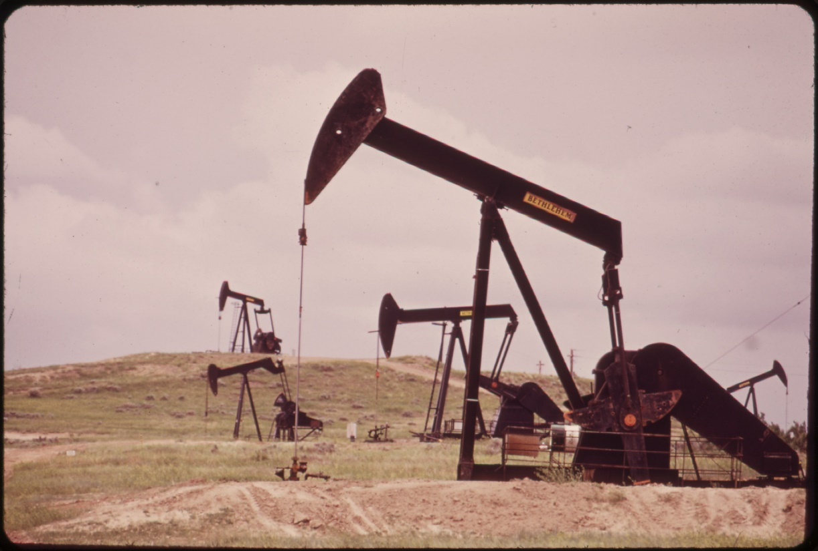
Problem
2d
The production of profiles of wells can be complex marked by a different events and unclear by data noise.
Petroleum Engineers spend a lot of time in the investigation process since they have to decipher the well production profiles, understand the underlying behavior, forecast the expected production and identify opportunities for performance improvement.
Inefficient work which creates many unidentified opportunities for any mature field

Slide 3
Approaches to Solve the Problem
3
1st Approach: QRI developed technology to assist part of the diagnoses and forecast through the use of advanced applied mathematics. The technology can be described as “hard-coded” intelligence.
2nd Approach: The question we would like to answer this summer is the following: “Can deep-learning algorithms be used to understand the behavior of oil wells?

Slide 4
Goal
4
Develop a machine learning tool to:
Forecast the expected production trends of a well
Identify historical production events
Model architectures we will focus:
Denoising- Autoencoders
Convolutional Neural Networks
Restricted Boltzmann Machine
Recurrent Neural Network

Slide 5
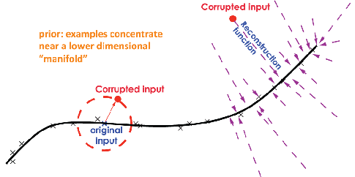
Denoising-Autoencoders
5
Feed forward neural network
A stochastic version of the auto-encoder
Instead of feeding to the auto-encoder the original input, we will feed a noise version of it
By adding noise we are forcing the hidden layer to:
- Learn about the structure of input distribution
- Learn more meaningful features

Slide 6
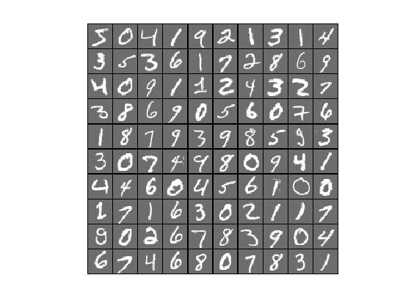
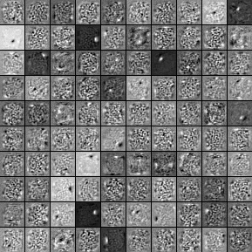
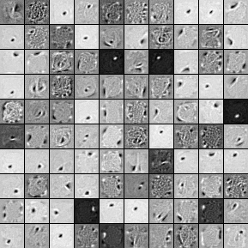
Denoising-Autoencoders
6
MNIST DATA
Train MNIST with noise. The resulting filters when we do not use any noise(normal autoencoder)
The filters for 30 percent noise. The filters are bigger, look at edge detectors.

Slide 7
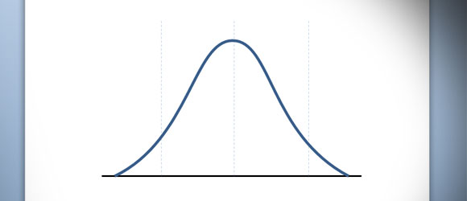
Denoising Auto-encoders- Sanity check
7
Working on: switching from denoising auto-encoder on (2D) images to denoising auto-encoder on(1D)
QRI time series data
Training data setup: Generate Gaussian curves with different mean standard deviations and add noise. Then see if network learned the patterns.
Using normal curves with mean 0, standard deviation 1 and 30% corruption. Sampling 100 points along the domain form -3 to 3.

Slide 8
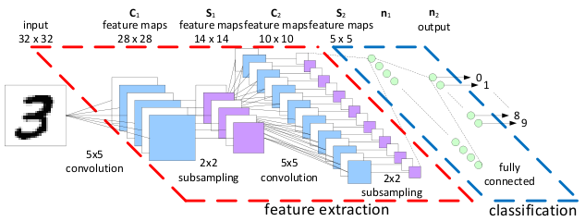
Convolutional Neural Networks
8
Feed forward neural network
Best at image recognition
Uses convolutions to detect features
1 dimensional filter in order to adapt for our problem
Making test data sets as prove of concept

Slide 9
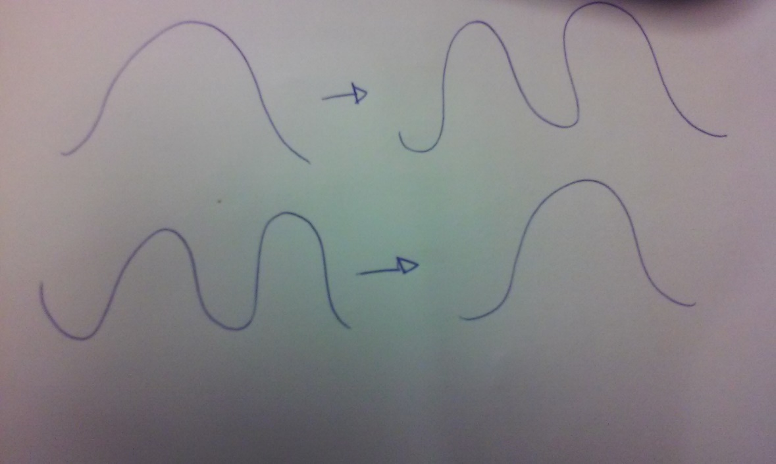
Convolutional neural network -Sanity check
9
Working on: Switching from Convolutional Neural Networks on (2D) images to Convolutional Neural Networks on(1D)
QRI time-series data
Training data setup: The input will be either one or two Gaussian curves and the expected output will also be one or two Gaussian curves

Slide 10
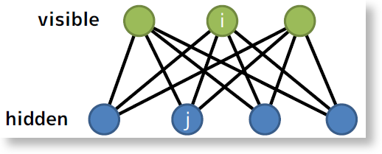
Restricted Boltzmann Machine
10
Not feedforward neural network/ bipartite graph
Generative model
Good at dimensionality reduction, and feature learning
“restricted” – no connections between units of the same type
Train with contrastive divergence algorithm

Slide 11
Restricted Boltzmann Machine- Sanity check
11
Will use same sanity check as denosing auto-encoders
Training data setup: Generate Gaussian curves with different mean standard deviations and will add noise. Then see if network learned the patterns.

Slide 12
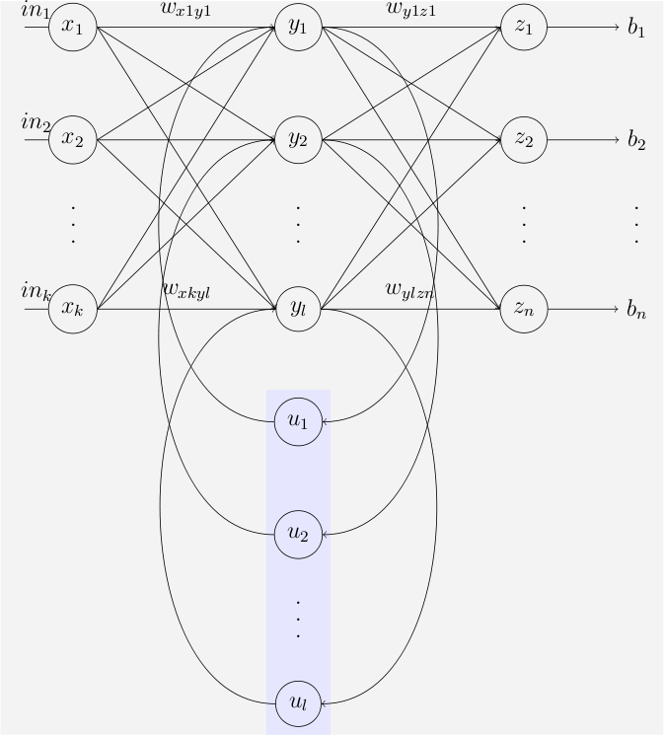
Recurrent Neural Network
12
Feedback neural network
Good at unsegmented connected handwriting recognition
Directed cycle
Training is considered more difficult
RNN are suited for one-dimensional array data

Slide 13
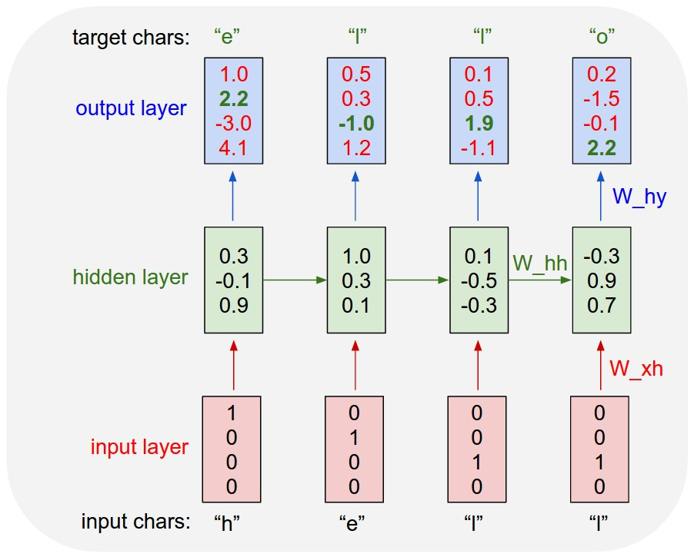
Recurrent Neural Network- sanity check
1313
Character level language Models
Code will be able to reproduce a reproduction of whatever text its feed in.
Working on:
Recreating the sanity check that was done using LUA, a programming language, through code in Python and Theano

Slide 14
Adapt Models to time series & Training Inputs-EXPECTED Outputs
14
Denosing auto-encoders, Convolutional Neural Networks , and Restricted Boltzmann Machine: Instead of training this networks with 2-D data such as images we will need to train them with 1-D images (time-series data)
Recurrent Neural Network: Training is already done with 1-D data (text/speech)
Training input : 36 data points (3 years of data) from a single oil well
Output: 12 data points predicted output from the same oil well for the next 12 months

Slide 15
Next Steps
15
Determine the optimal learning rate and number of hidden layers in our network for minimum processing time and maximal accuracy.
This process is anticipated to take two to three hours for each iteration of the neural network being tested. We will be using the Cluster.

Slide 16


